Slide 1

Climate Change Analysis
Team Members (Group ID - 12):
Anuj Shrivastava (21111013) - anujs21@iitk.ac.in
Himanshu Lal (21111403) - himanshul21@iitk.ac.in
Jegan Balaji B S (21111404) - jeganb21@iitk.ac.in
Manish (21111036) - manishv21@iitk.ac.in
Shivam Tripathi (21111408) - shivamtr21@iitk.ac.in
CS685A: Data Mining Project
Guide:
Prof. Arnab Bhattacharya
Computer Science and Engineering,
Indian Institute of Technology (IIT), Kanpur.

Slide 2

Introduction
In today’s era, large-scale industries are fueling environmental degradation which when combined on a global scale can cause extreme weathers, economic loss, and frequency of natural disasters. Therefore, we need to act on the sources that are inducing climate change and in-turn reduce the rate of global temperature rise.
We aim to analyze the common factors that induce climate change.
Global Greenhouse-Gas Emissions
Rise in Temperature
Melting of Glaciers
Rise in Sea-level
Plastic Waste in Oceans
Deforestation and Correlation with Endangered Indigineous Species
Natural Disasters

Slide 3
Greenhouse-Gas Emissions
Greenhouse gases trap heat and make the planet warmer. These gas absorb and emit radiant energy within the thermal infrared range, causing the greenhouse effect.

Slide 4
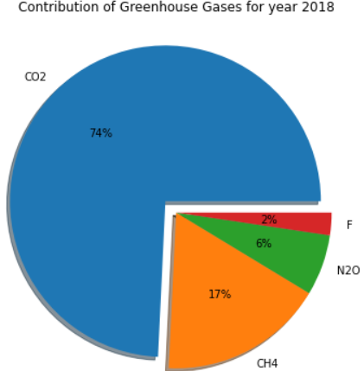
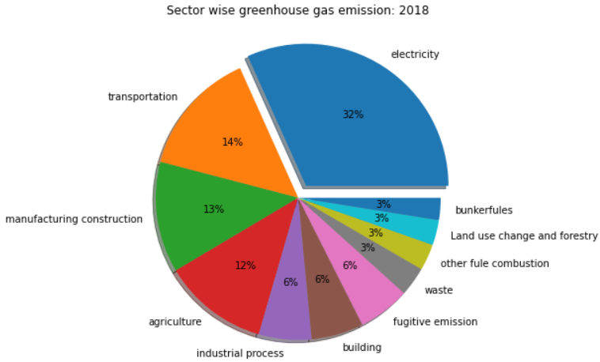
Analysis on
Greenhouse Gases
Sector Wise Greenhouse Gas Emission

Slide 5
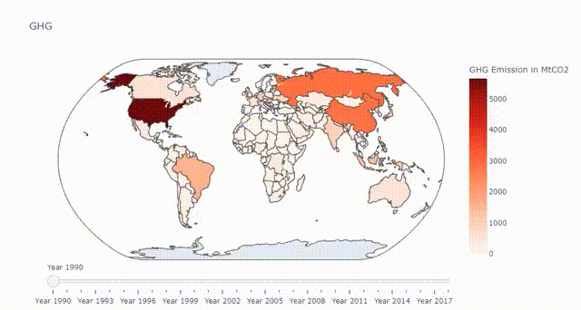
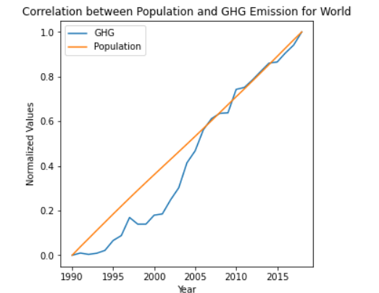
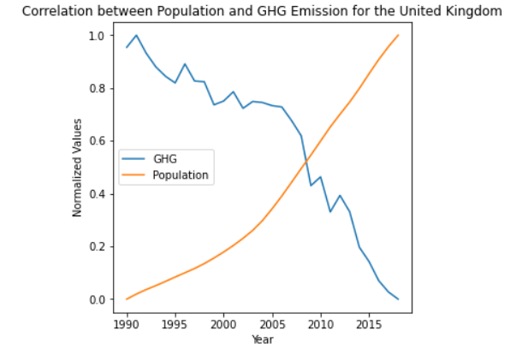
Correlation between GHG Emission and population
Change in global GHG emission over the last 29 years

Slide 6
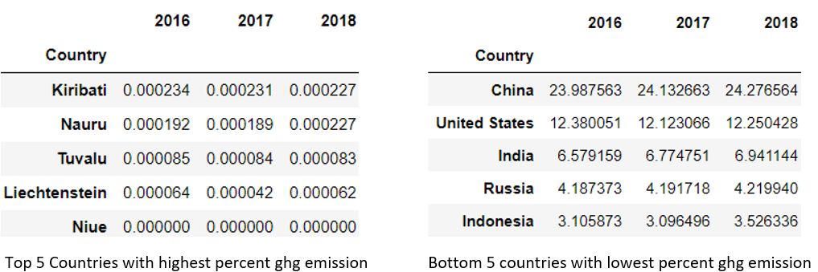
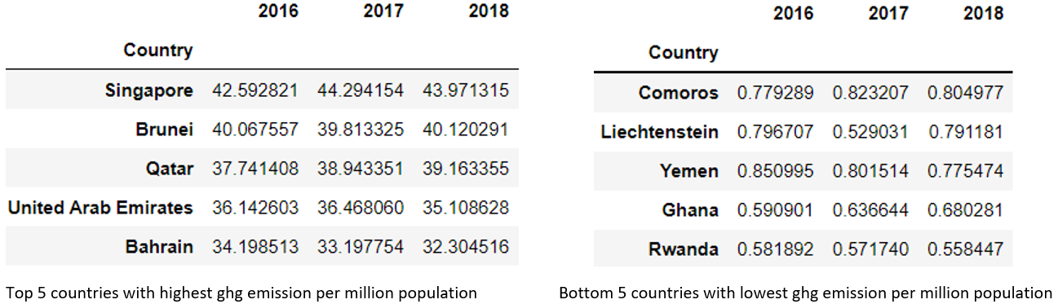
Top 5 Highest and Lowest producers of GHG Emission per million population
Top 5 highest and lowest producers of GHG

Slide 7
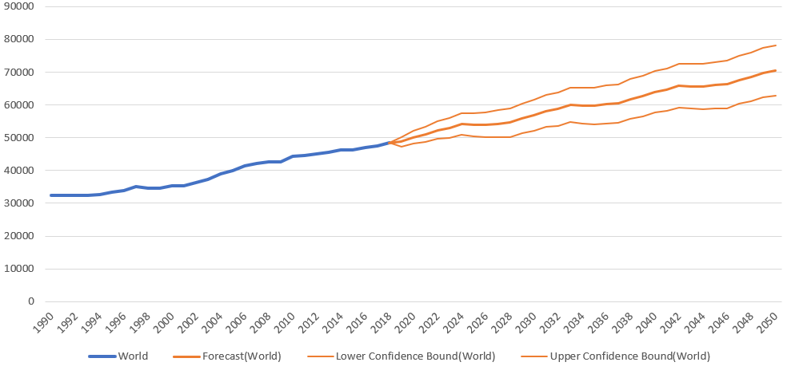
Greenhouse Gas Emission Forecasting
In the last 29 years, the emission of greenhouse gases increased from 32K mtCO2 to 48K mtCO2 and reaching the year 2050, it will cross the mark of 70K mtCO2. It is heavily dependent on the population and sectors like electricity and transportation.

Slide 8
Rise in Temperature
We will investigate the change in temperature over the years across each country and every climatic region.

Slide 9
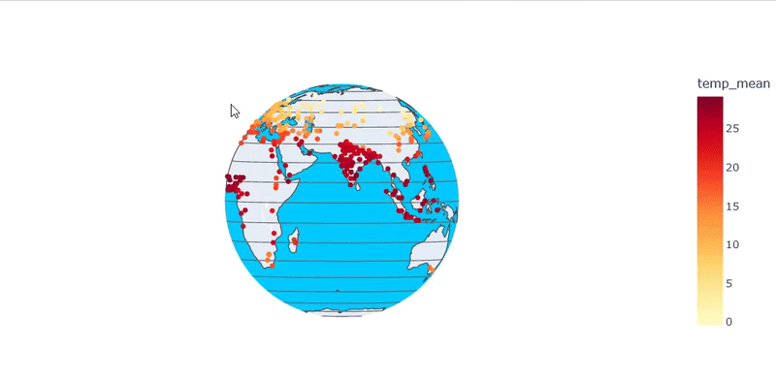
Yearly City-wise Average Temperature Visualization

Slide 10
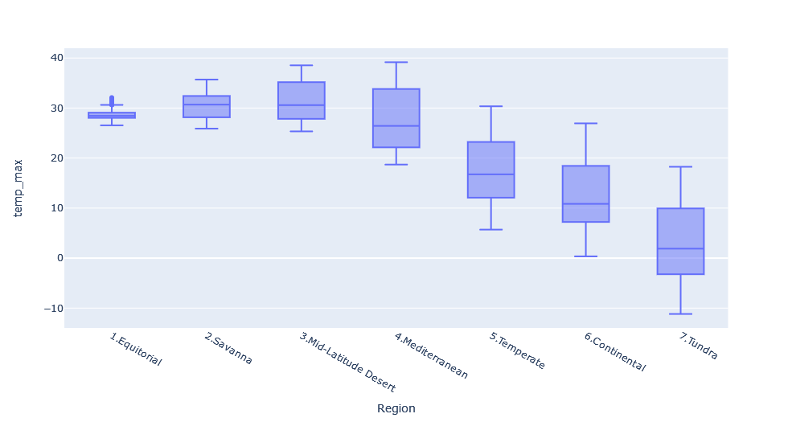
Box Plot Showing Max Temperature Range Recorded Over The Years For Each Region

Slide 11
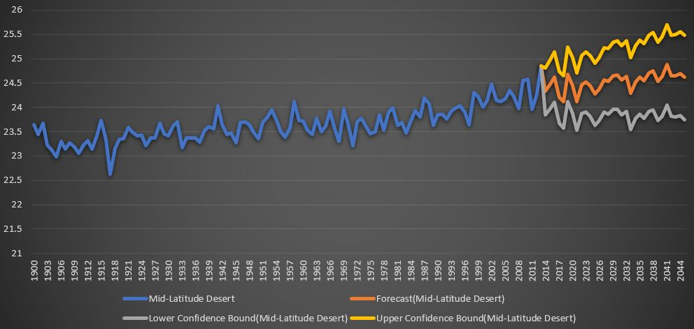
Temperature Forecasting (2013-2045) Mid-Latitude Desert Climate region
Temperature Change is more intense at places closer to poles than the ones near the equator

Slide 12
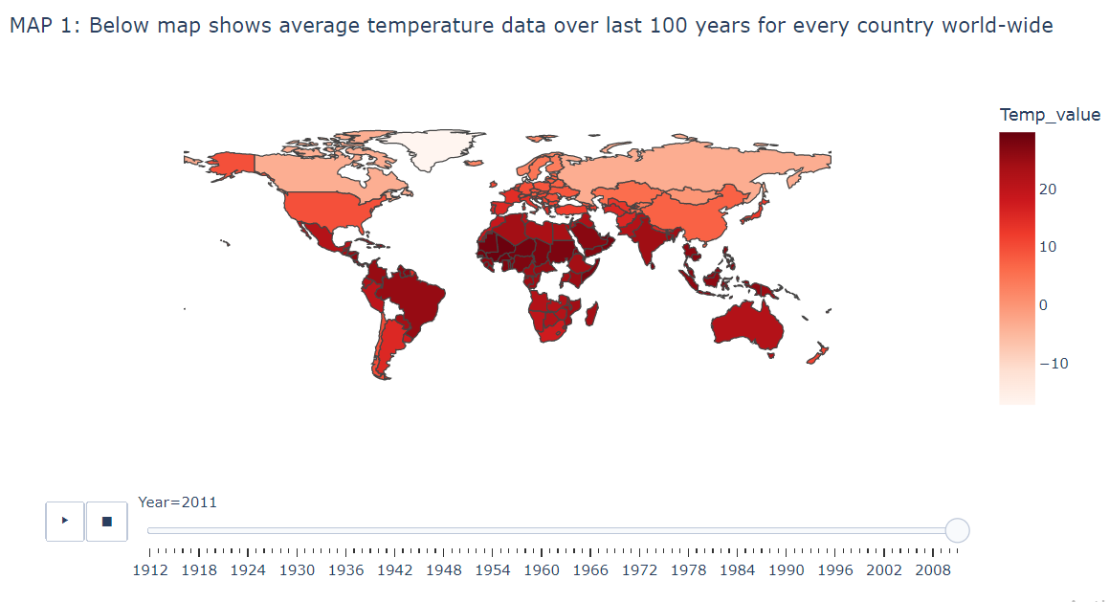
Country-wise average Temperature Visualization for
Year 2011 (world-wide) .

Slide 13
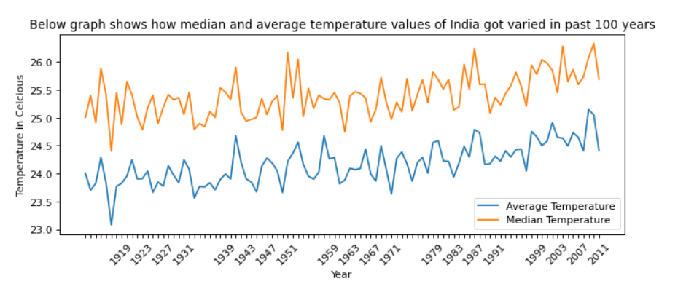
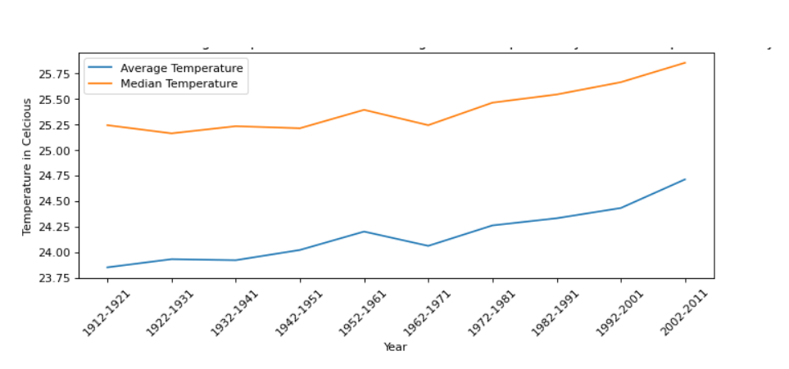
Rise in Temperature
We can clearly visualize from the graphs that average and median temperature value is rising at a certain rate year by year. The rate is increasing year by year. If this rate would keep increasing, it’ll lead to lots of problems including risk to public health. The risk to public health are greatest when high temperatures mix with other weather conditions to cause what’s known as an ‘Excessive Heat Event’.
Below graph shows same data with 10-year moving average in past 100 years.

Slide 14
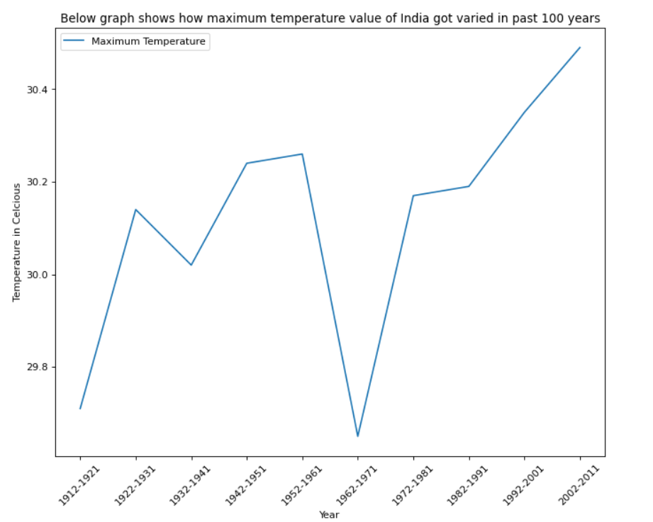
Rising value of maximum temperature occurring every year
So as we can see from graph, maximum temperature value is also increasing year by year.
Most climate change experts agree that greenhouse gases ― which trap heat and prevent it from leaving the Earth's atmosphere ― are mostly responsible for the temperature spike. Even with a worldwide emphasis on reduced greenhouse emissions, temperatures values continue to climb. That’s the main reason why every summer we feel temperature more than the previous year summer.

Slide 15
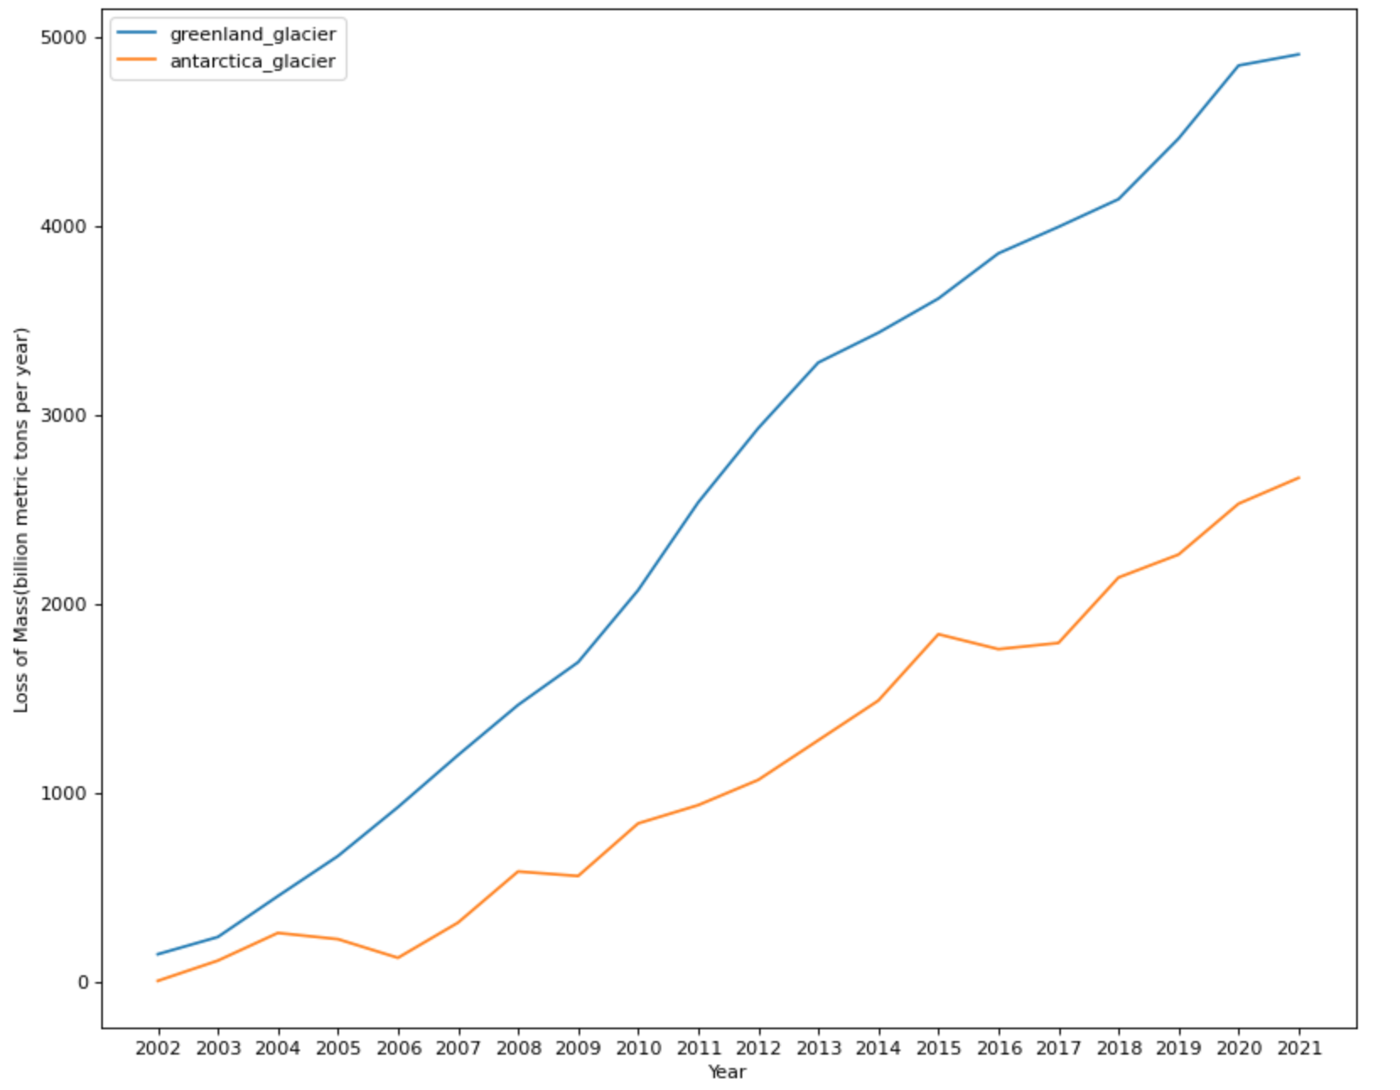
Melting of Glaciers
Glaciers are melting at a very high speed.
According to 3D satellite measurements of all the world's mountain sources, we are losing 31% extra snow that we used to lose 15 years back.
Scientists across the world are blaming human activities for this high rate.
Using recent satellite data, scientists are suggesting that we are losing around 300 billion metric tons of ice and snow since 2015.

Slide 16
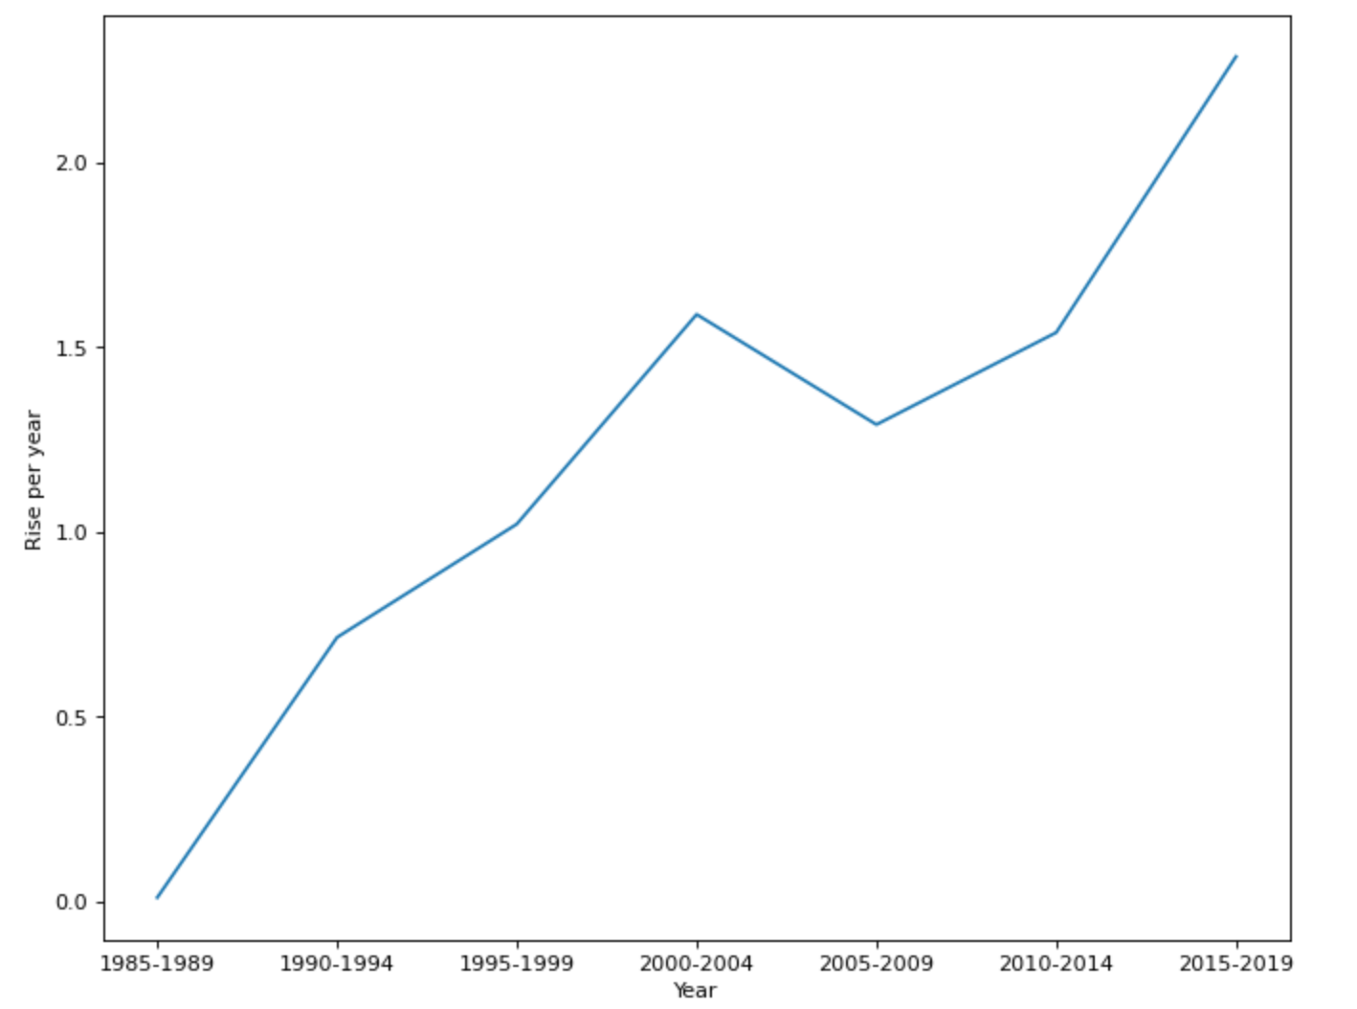
Rise in Sea level
Rise in Sea-level (1985-2019)
We can clearly visualize that Sea level is rising at a very high rate. The rate is increasing year by year. If this rate would keep increasing, we may lose 50% of Mumbai, Cochin, Bhavnagar, Mangalore, Chennai and many more cities by this century.

Slide 17
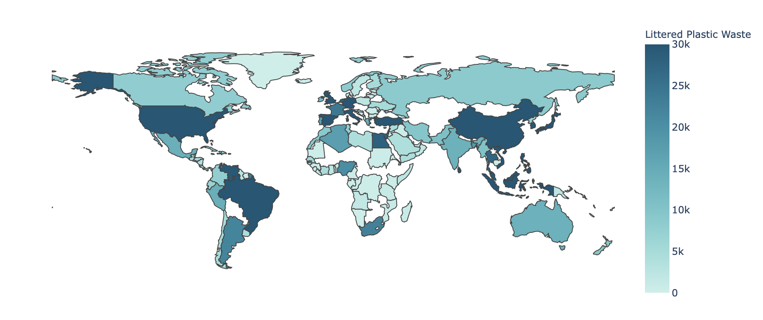
Plastic Waste from countries
MAP : Coastal Population VS Littered Plastic Waste
Rising Sea levels and melting of glaciers are not only problems going in oceans, but they are even more big problems which will affect human and aquatic lives in a very dangerous way.
One of them is Mismanaged Plastic wastes which goes in the oceans through various ways.
Now, when the sea animals consume these plastics, those toxins from plastics breaks inside their bodies.
Then human consuming those seafoods are also consuming these toxins. The problem is that some of these toxins are linked to hormonal inabilities and developmental problems.

Slide 18
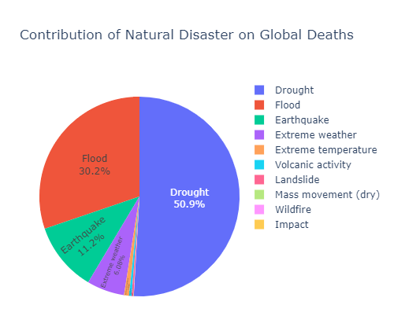
Natural Disasters
Top 3 Natural Disasters by Number of Global Deaths:
We analyze the global data for common natural disasters.
Draught
Flood
Earthquake

Slide 19
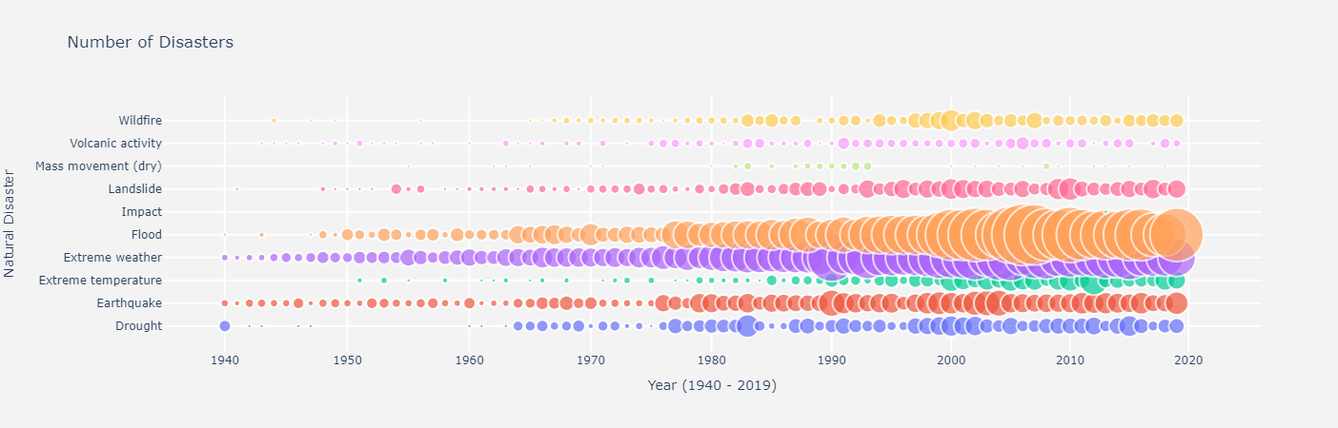
Frequency of Natural Disasters has Increased in the Past Few Decades

Slide 20
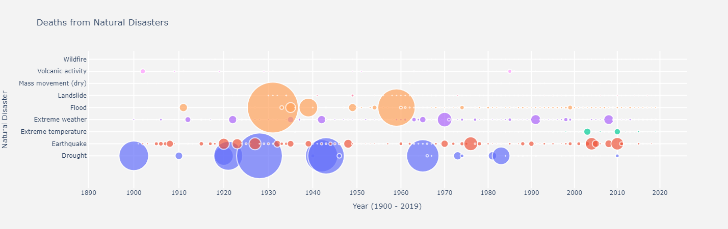
Draught, Floods, and Earthquakes Have Wrecked the Most Havoc

Slide 21
Deforestation
We will investigate if there is any relationship between the amount of forest area lost due to deforestation and the number of endangered indigenous species.

Slide 22
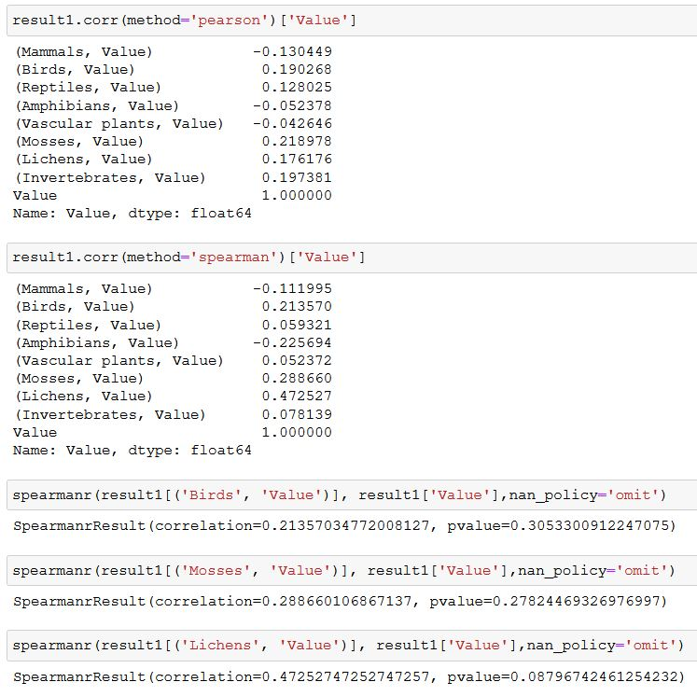
We calculated the pearson and spearman correlation coefficient between the amount of forest area lost due to deforestation and the various number of endangered indigenous species.
There seems to be a weak positive correlation between the amount of forest area lost due to deforestation and the number of endangered indigenous species for :
Birds
Mosses
Lichens

Slide 23
Conclusion
In this project we have analyzed the data for common factors that induce climate-change. These events are highly correlated.
High GHG-Emission causes Global Warming
Global warming Melts the Ice-Sheets and Glaciers
Melting of Glaciers Causes a Rise in Sea-Level
The combined effect of the above results into frequent natural disasters and climate anomalies.

